Slide 1
Control Unit

Slide 2
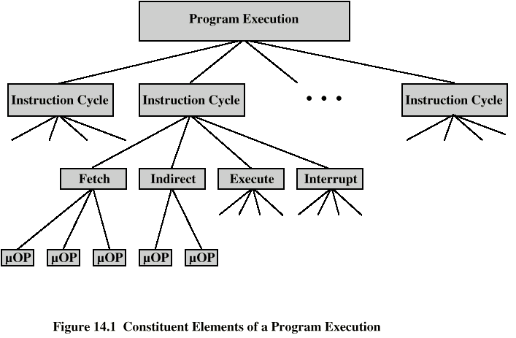
Micro-operations: atomic operations of a processor.
Need to tie sequences together.
Instruction cycle code (ICC) designates which part of cycle processor is in.

Slide 3
Fetch Sequence
t1: MAR <- (PC)
t2: MBR <- M(MAR)
PC <- (PC) + ∆
t3: IR <- (MBR)
(tx = time unit/clock cycle)

Slide 4
Rules for Grouping
Proper sequence must be followed
MAR <- (PC) must precede MBR <- M(MAR)
Conflicts must be avoided
Must not read & write same register at same time
MBR <- M(MAR) & IR <- (MBR) must not be in same cycle

Slide 5
Control Unit
The control unit is the portion of the processor that:
issues control signals internal to the processor to move data between registers, to cause the ALU to perform a specified function, and to regulate other internal operations.
issues control signals external to the processor to cause data exchange with memory and I/O modules.

Slide 6
Functional Requirements
Basis for design and implementation of the control unit.
Characterization of the control unit:
Define the basic elements of the processor.
ALU
Registers
Internal data paths
External data paths
Control Unit
Describe the micro-operations that the processor performs.
Transfer data between registers
Transfer data from register to external
Transfer data from external to register
Perform arithmetic or logical ops
Determine the functions that the control unit must perform to cause the micro-operations to be performed.

Slide 7
Functions of Control Unit
Sequencing
Causing the CPU to step through a series of micro-operations
Execution
Causing the performance of each micro-op
This is done using Control Signals

Slide 8
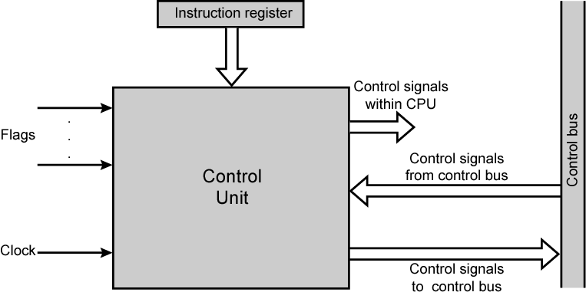
Control Unit

Slide 9
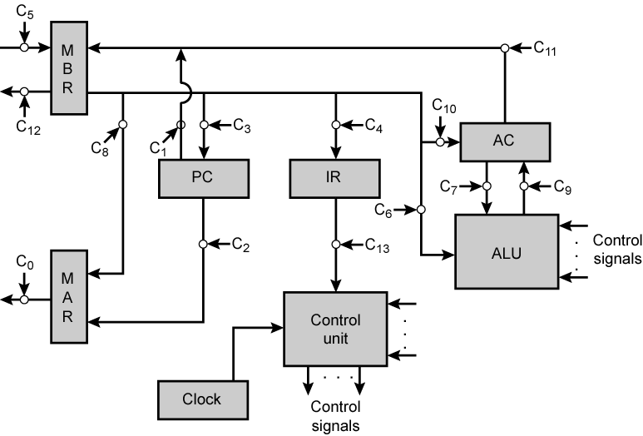
Data Paths and Control Signals

Slide 10
Hardwired Implementation
In a hardwired implementation, the control unit is essentially a logic circuit, featuring a finite number of gates.
Its input logic signals are transformed into a set of output logic signals, which are the control signals.
Design uses a fixed architecture—it requires changes in the wiring if the instruction set is modified or changed.

Slide 11
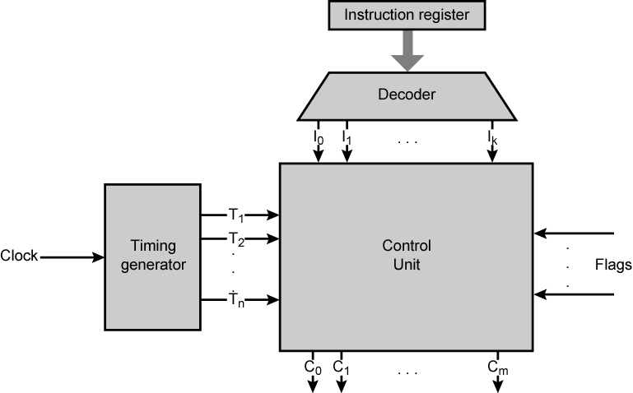
Hardwired Implementation

Slide 12
Micro-programmed Control
Microprogrammed control is a control mechanism that generates control signals by reading the memory called control memory that contains control words.
Use sequences of instructions to control complex operations.
Called micro-programming.
Firmware: Firmware is a pre written program that is stored in ROM. It configures the computer and not easily modified by users.
Microinstruction: an instruction stored in control memory. It is a set of micro-operations occurring in the same unit of time.

Slide 13
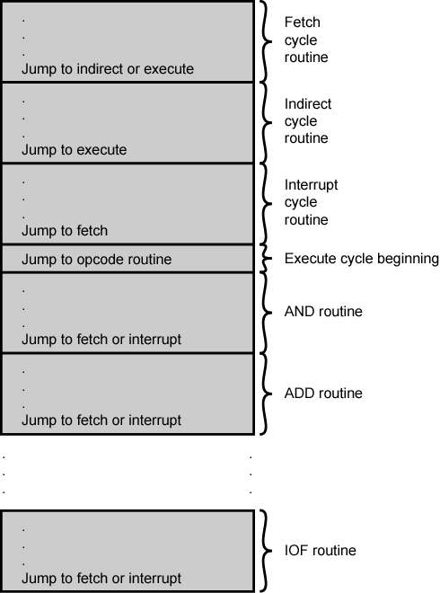
Organization of Control Memory

Slide 14
Micro-instruction Types
Horizontal
Vertical

Slide 15
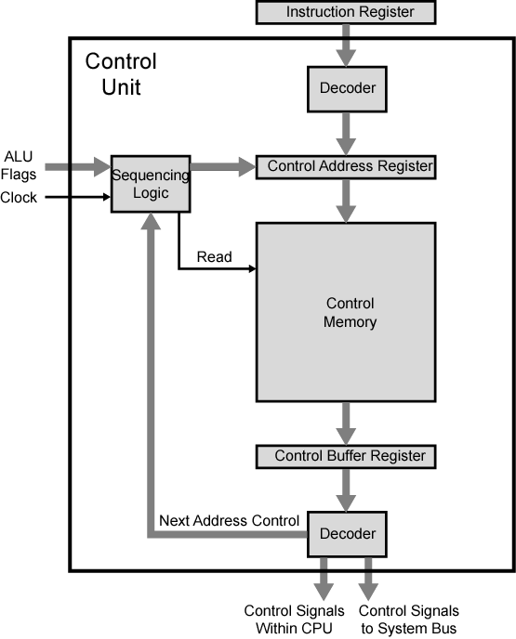
Microprogrammed Control Unit

Slide 16
Reference
Computer Organization and Architecture: Designing for Performance, William Stallings, 6th Edition, Pearson India.

